Slide 1

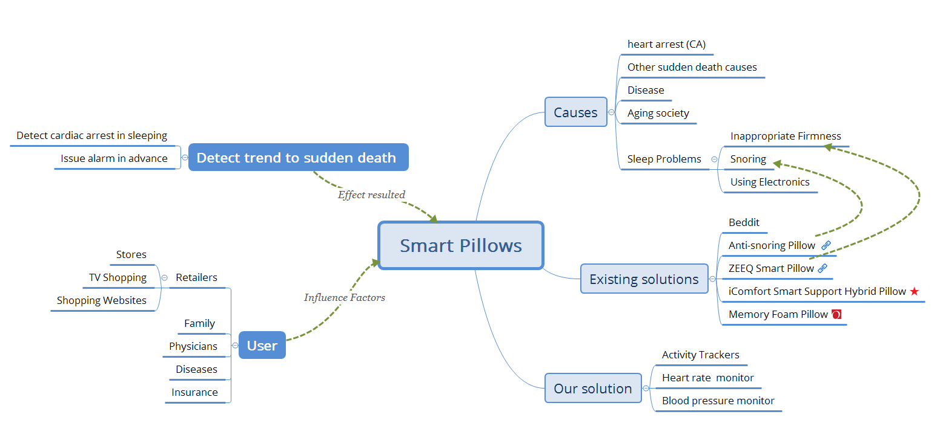
Project Title
Problem
Opportunity
Solution
Resources
Sudden adult death syndrome or sudden unexpected/unexplained death syndrome (SUDS) is a sudden unexpected death of adolescents and adults, mainly during sleep. What’s more, the seniors have more chance to sudden death during sleep.
The main cause of sudden death during sleep is heart arrest (CA), and it’s difficult to detect without professional equipment.
Our idea is to design a smart pillow with sensors, which could detect the trend to sudden death and issue alarm in advance.
Seniors have more risk in sudden death during sleep. According to the World Health Organization, the current life expectancy is around 70-72 years of age. This means that we’re now in the aging society. Aging society and lonely seniors exacerbate the risk of sudden death of senior people.
The American Heart Association in June 2013 at the "Circulation" magazine pointed out that heart arrest was one of the deadliest public health problems in the United States.
One related or similar solution is “Beddit” which focus on sleep quality improvement, and it’s not about sudden death detection and alarm.
Pillow is our necessity in daily life. Every night, we go to sleep with the support of pillow.
Our solution is provide heart rate and blood pressure monitor to detect cardiac arrest in sleeping. 3D pressure sensor matrix and flat photoplethysmogram-pulse-wave-velocity(PPG-PWV) sensor matrix, computing and communicating circuit are embedded in the pillow. 3D pressure sensor matrix locates user’s carotid artery, and activate the exact PPG sensor and PWV sensor under carotid artery. The PPG sensor collects PPG signal and the embedded the computing circuit tracks heart rate with PPG signal. The PWV sensor collects PWV signal and the embedded the computing circuit tracks blood pressure with PMV signal.
If the computing circuit finds any abnormal information indicating high possibility of cardiac arrest, it will make communicating circuit to dial 911 to get emergency help.
We need $3000 to implement our project. Our team will use these DifferenceMaker funds to design 3D pressure sensor system, and design smart pillow which embed 3D pressure sensor system.
We have an estimated budget for use of DifferenceMaker funds:
Team building: cooperate with students of mechanical engineering to help us design the smart pillow.
Incorporating as a business/nonprofit: design a business plan to get our products onto the market.
Customer investigation: interview with 30 to 40 people to investigate their sleep habitat, disease, and sleep quality.
Design solution: design a better solution of smart pillow.
Product/program development: prototype design, product design, and program development.
Product/program test: acquire some tests in the lab when implementing our solution. Our partners and customers can give our advice and review on our prototype.
.
Free Space to Utilize for What You Feel is Necessary
Pictures, Graphics, Charts, Tables, etc.
Our solution provides a smart pillow with an automated monitoring system to detect the trend of sudden death and issue alarm in advance.
This project's goal is to design a smart pillow with a monitoring system to detect abnormal symptoms of sudden unexpected death during sleep. By monitor heart rate and blood pressure, the smart pillow can detect cardiac arrest in sleeping. Existing solutions focus on sleep quality improvement, and it’s not about sudden death detection and alarm.
This project aims to provide people especially seniors with an in-sleep monitoring system that will decrease or avoid sudden unexpected death during sleep.
Team Member Names, Majors, and Years in School
Weiwei Li, Computer Science, PhD Second year
Jinhong Cui, Computer Science, Master first year
Zhiping Fu, Computer Science, Master first year

